Slide 1


Fastest Laundry Service
TEAM NAME:
“Thug Life”
TEAM MEMBERS Sridevi A
Aarthi S
Sukhetha R
Gayathri K
Karthikeyan TR
Ganesh S

Slide 2

OVERVIEW
.
Fastest Laundry is a startup company, it offers premium Laundry services in the Hyderabad region. The firm offers an affordable laundry service with door to door pickup and delivery. They also offer Express Fastest Laundry Service. They also offer to track the status of your laundry.

Slide 3

ACTORS INVOLVED
Customer – Logs in as guest and requests for the services offered by the company.
Pickup Assistant – Picks-up the laundry from the customer.
Delivery Assistant - Delivers the laundry to the customer.
Darning Specialist - Skilled to the darning work.
Dry-Cleaning Specialist - Skilled to do dry cleaning related work.
Iron Specialist - Skilled to Ironing work.
Wash Specialist - Skilled to do the Washing work
Starching Specialist - Skilled to do the starching work.
Laundry Administrators - Manage the overall application and oversee the works done by the various role holders.

Slide 4
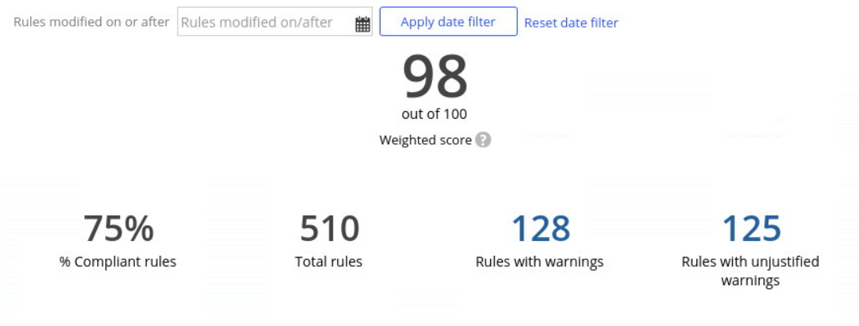
COMPLIANCE SCORE

Slide 5

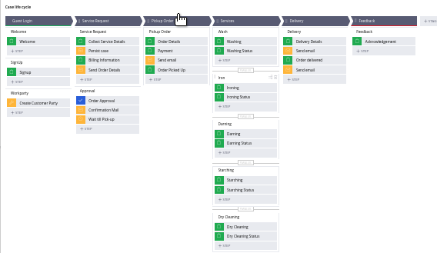
HAPPY PATH
Case Type: Place Order
Happy path describes the normal flow of the case...

Slide 6
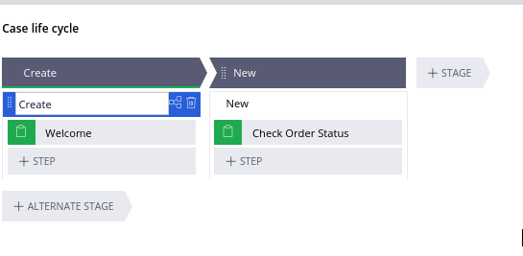
HAPPY PATH
Case type: Track Order

Slide 7

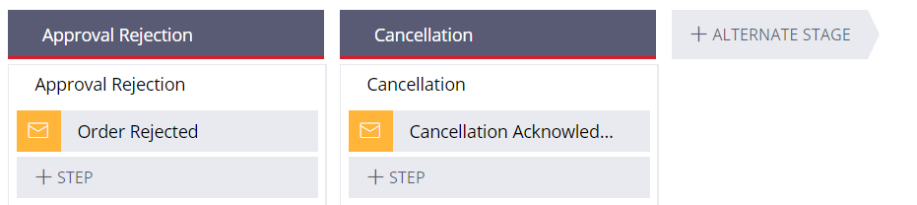
ALTERNATE PATH
An alternate stage is defined as an out of sequence event in the life cycle of a case .

Slide 8
CONCEPTS COVERED
DATA TRANSFORM
DATA TYPES
CORRESPONDENCE
DELEGATION
CIRCUMSTANCE
VALIDATIONS
WORK PARTIES
SERVICE LEVEL AGREEMENTS
REPORTS
ROUTING

Slide 9
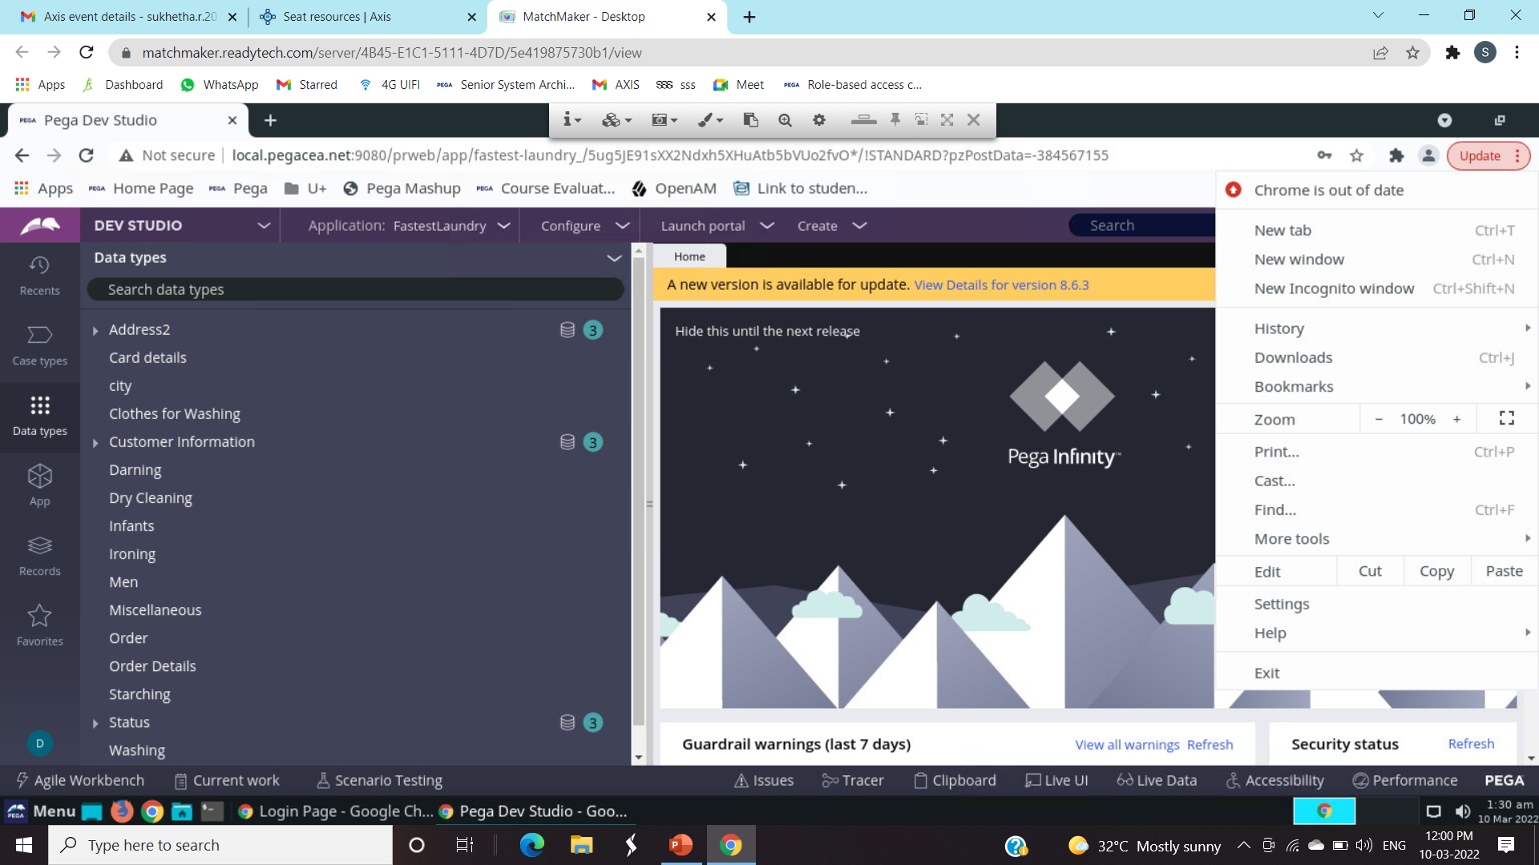
DATA TYPES

Slide 10
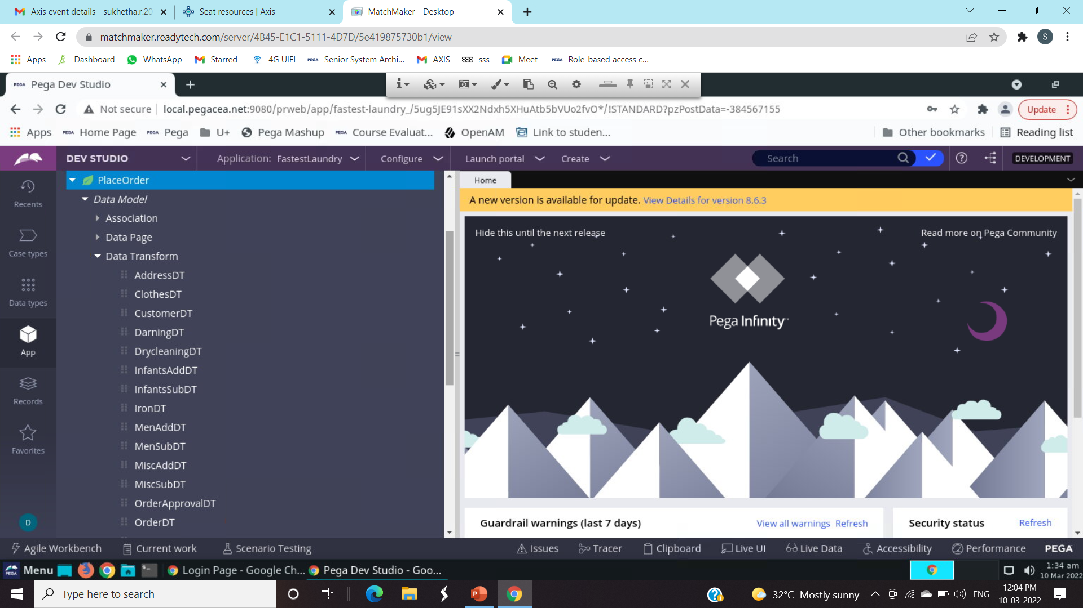
DATA TRANSFORM

Slide 11
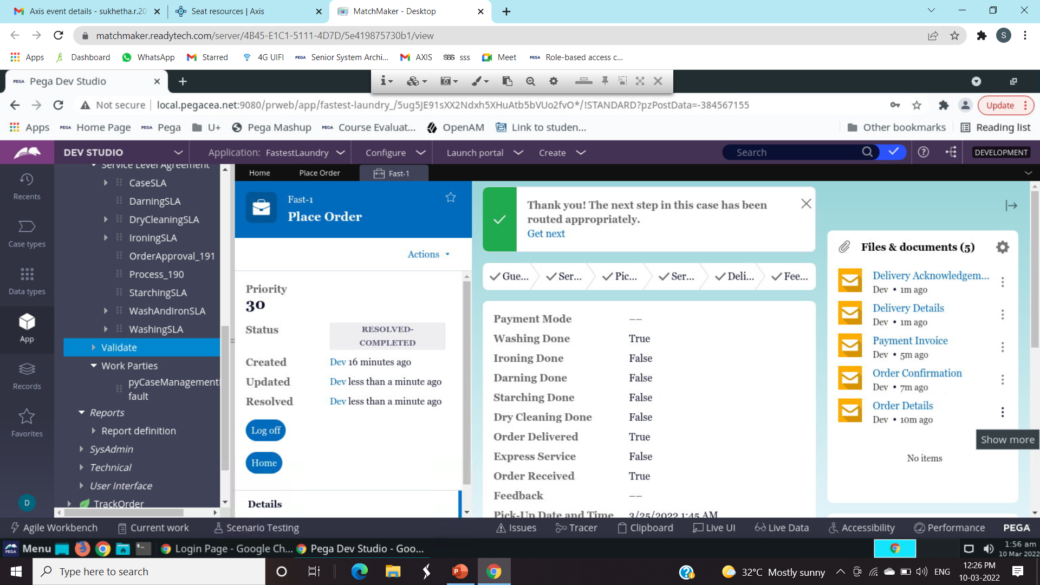
CORRESPONDENCE

Slide 12
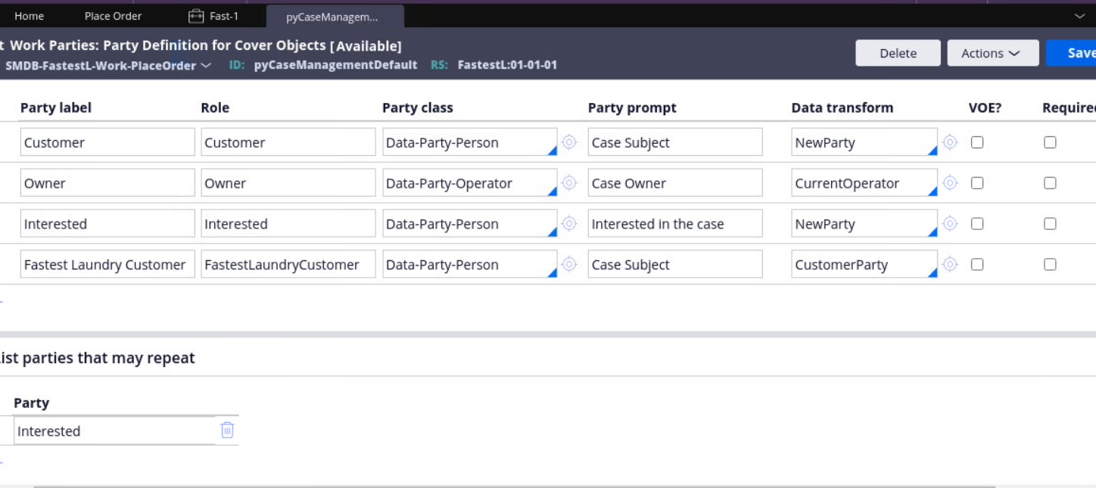
WORKPARTY

Slide 13
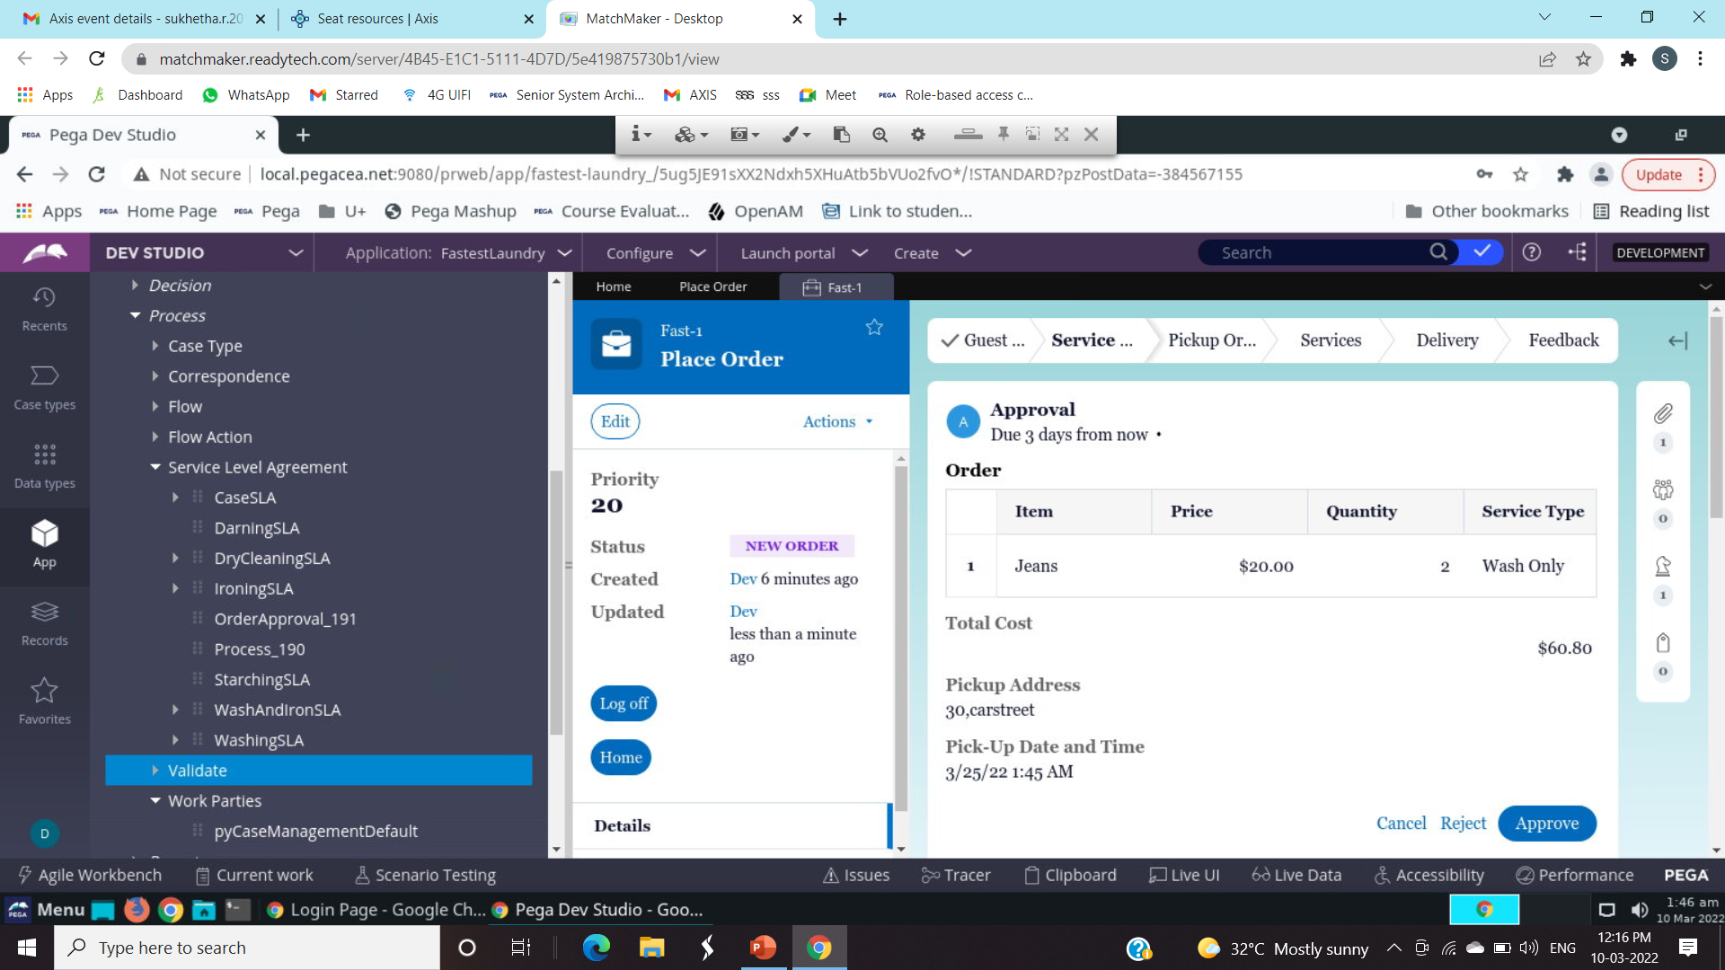
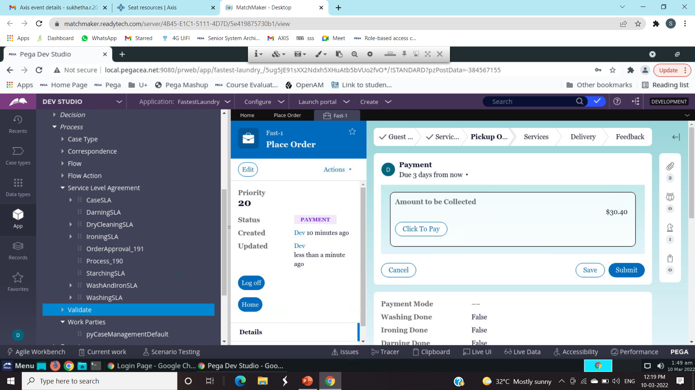
SERVICE LEVEL AGREEMENT

Slide 14
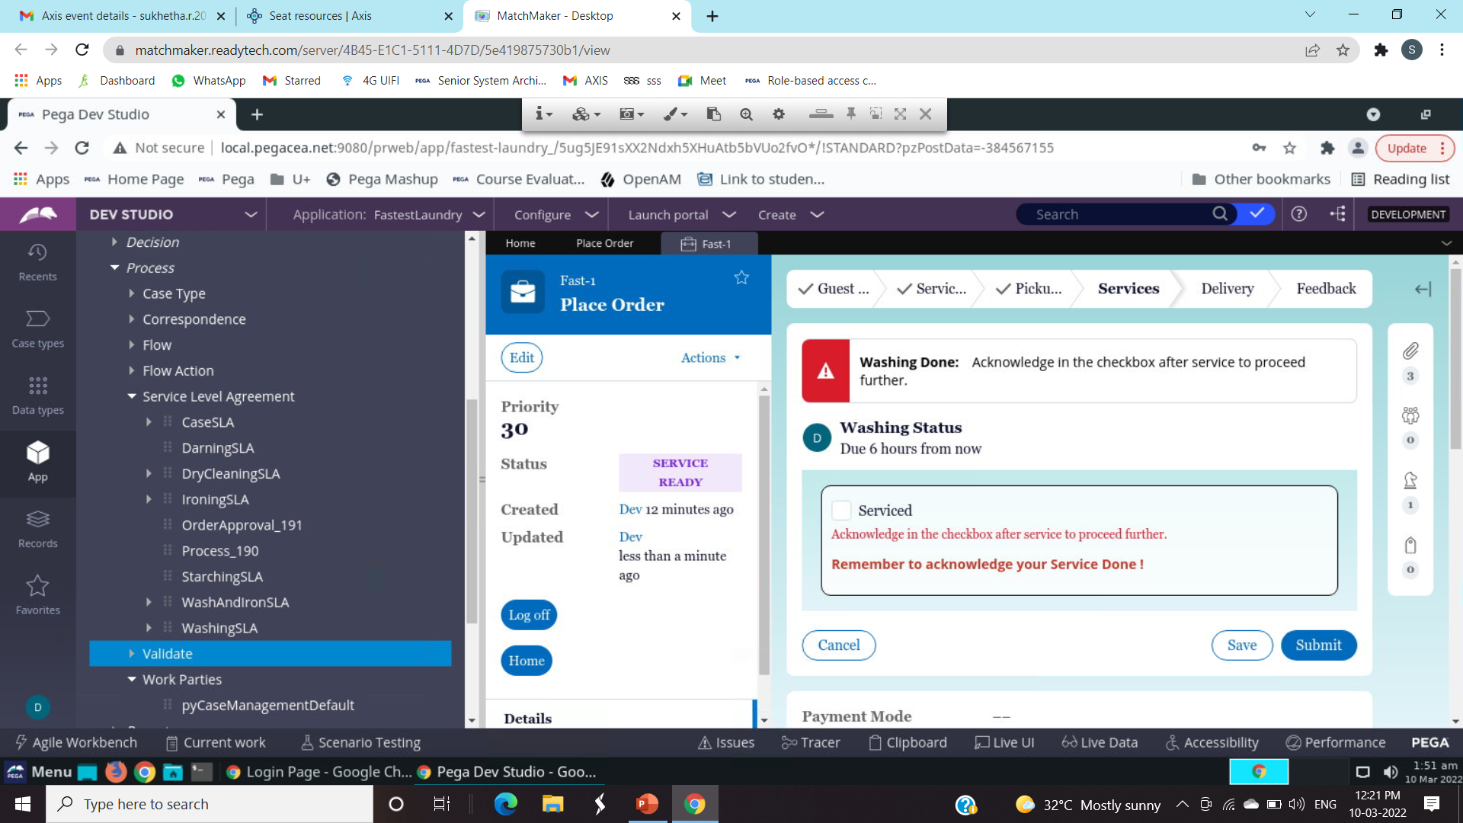
VALIDATIONS

Slide 15
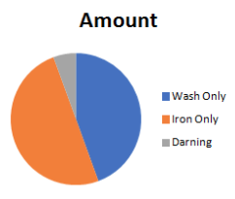
REPORTS
When designing reports, knowing what information the user needs and how it will be used is important. Pega Platform provides reporting features for developers, business analysts, and managers so that you can create simple or complex reports to satisfy your business needs

Slide 16
DELEGATION
A delegated rule is one that appears for a specific group of users so that they can manage these rules outside the development environment . For a single user or a group of managers associated with a specific access group , these rules appear in the manager portal .

Slide 17
THANK YOU !

